Slide 1
Understanding Academic English
Academic Writing Course

Slide 2
Contents
1
Definition of academic writing
2
Features of academic writing
3
Language styles/Degree of formality
4
Ways to write academically
5
Practice

Slide 3

What is academic writing?
Discussion
Descriptive writing
Narrative writing
Expositive writing
Argumentative writing
Essay writing
term papers
lab reports
journal papers
conference papers
theses and dissertations
literature reviews
Research writing
research writing—writing done to generate and to disseminate knowledge that is produced by research
Argumentative research paper
Analytical research paper

Slide 4

Discussion
Features of academic writing?
Structure
Idea development
Analytic approach
Use of sources
Explicitness
Language
→clearly structured
→logically developed
→analytical
→based on sources
→explicit
→objective, cautious and formal

Slide 5
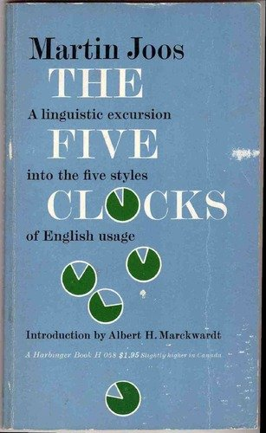
What language styles?
the frozen style
the formal style
the consultative style
the casual style
the intimate style
庄严体
正式体
商议体
随意体
亲密体

Slide 6





Read and Decide
1) My dear father has just expired.
2) My old man just kicked the bucket.
3) My dad has died.
4) My beloved parent has just passed to his heavenly reward.
5) My father has just passed away.
--- by Martin Joos
Frozen Formal Consultative Casual Intimate
( ) ( ) ( ) ( ) ( )

Slide 7
Read and Decide
Huzzah! We won! We beat ‘em! Ha! Blue Vam­pires. They think they’re so great. We showed ‘em. Go Aardvarks! | I’m so glad for our team, the great Fighting Aardvarks, and now together we celebrate this victory. | The Fighting Aardvarks claimed victory over the Blue Vampires in the final round tonight. Both teams competed well and the fans are enthusiastic.
Yuck! I hate broccoli with those nasty, stinkin’ mush­rooms. Why do we gotta have these things again, man?! | I’d prefer not to have this particular vegetable again, if it’s possible. Does anyone really enjoy this combination of mushrooms and broccoli? | Very few people enjoy this broccoli and mushroom dish. Therefore, it will not be served again within this calendar year, or the servers will be killed.
Casual tone
Consultative tone
Formal tone

Slide 8
Read and Decide
It’s possible that our party might have to be postponed or canceled because of the bad weather that’s threatening our location. | Due to the inclement weather, the Annual Tattoo Party will not take place this Thursday at Finster Park. The planning committee will reschedule the event and release information as soon as possible. | www, we gotta cancel the party ’cause it’s totally raining like crazy!
Indiana Jones films are really very popular with your age group. Critics can’t decide why such an old character is so appealing. | Hollywood is perplexed at the reasons that Indiana Jones is so favored by such young audiences. The answer remains a mystery. | Sweeeet! I love those Indiana Jones movies! They’re awesome with the whip and the bugs and stuff. Everyone loves those flicks!
Consultative tone
Formal tone
Casual tone

Slide 9
Read and Compare
Announcement from the Librarian
Passage A
It has been noted with concern that the stock of books in the library has been declining alarmingly. Students are asked to remind themselves of the rules for the borrowing and return of books, and to bear in mind the needs of other students. Penalties for overdue books will in the future be strictly enforced.
Passage B
The number of books in the library has been going down. Please make sure you know the rules for borrowing, and don't forget that the library is for everyone's convenience. So from now on, we're going to enforce the rules strictly. You have been warned.

Slide 10
Discussion
Features of 3 tones
Casual tone | Consultative tone | Academic tone
incomplete and simple sentences
the 1st or 2nd person
emotional words
small words
exclamation marks
abbreviated forms
slang/colloquial words
casual fillers, such as “you know”, “well” etc.
complete and somewhat complex sentences
the 1st or 2nd person
emotional words
big words
passive voice
contracted forms of verbs
complete and complex sentences
the 3rd person
impersonal words
big words
passive voice
logical connectives

Slide 11
Discussion
Purposes of using 3 tones
tones | purposes
Casual
Consultative
Academic
Used for daily personal communication, usu. between friends and people familiar to each other
Used for expressing common opinions, attitudes, suggestions and persuasion, etc.
Used for academic purposes, such as publishing research results, writing academic papers, etc.

Slide 12

How to write in a formal way?
Lexical Level | Syntactic Level
1. Use big and long words
2. Avoid using phrasal verbs
3. Don’t use colloquial and slang expressions
4. Use impersonal language
5. Use nominalizations
6. Don’t use clipped words and contractions
1. Use long and complex sentences rather than short ones
2. Use participial phrases
3. Use Nominative absolute constructions
4. Use passive voice rather than active voice

Slide 13

P4-5
Which column of the words will you use in your academic research paper?
formal | Informal
verify
examine
penetrate
demonstrate
conclude
eliminate
discover
numerous
investigate
intend
verify
examine
penetrate
demonstrate
conclude
eliminate
discover
numerous
investigate
intend
show
a lot of
end
get through
make sure
look at carefully
look into
mean
get rid of
try to find out
make sure
look at carefully
get through
show
end
get rid of
try to find out
a lot of
look into
mean

Slide 14
Read and rewrite
Read and rewrite the following sentences in an academic voice
1. Researchers looked at the way strain builds up around a geological fault.
2. Lots of job loss is just one thing resulting from automation.
3. When you read Hamlet, you should notice clear foreshadowing of events to transpire.
4. Scientists discovered how to fuse atoms. This led to the development of the atomic bomb.
5. When the captain heard a storm was coming, he decided to put off the voyage.
Researchers examined the way strain intensifies around a geological fault.
Widespread unemployment is one consequence of automation.
Clear foreshadowing of events to transpire should be perceived in Hamlet.
The discovery of atomic fusion contributed to the development of the atomic bomb.
Having been warned of the impending storm, the captain decided to postpone the voyage.

Slide 15
Read and rewrite
P5
Read and rewrite the following sentences into a text with well-organized sentences and structural complexity
A conjunction connects words, phrases, or clauses. It indicates the relationship between the elements. These elements are connected together. We often find the following thing. In only one single sentence a conjunction contains one or more ideas. These ideas may be equal or unequal in importance. Ideas are equal, and we call them coordinate ideas. For example, John studies electronics. Helen studies computing. These two sentences can become a compound sentence. It shows the relationship between the two ideas. We want to maintain the equality of the ideas in such a way. We call the clauses in the new sentence coordinate clauses.

Slide 16
Key for Reference
A conjunction connects words, phrases, or clauses and can also indicate the relationship between the elements it connects. In only one single sentence we often find one or more ideas which may be equal or unequal in importance.
When the ideas are equal, they are called coordinate ideas. For example, the two sentences “John studies electronics.” and “Helen studies computing.” can be joined into a compound sentence that shows the relationship between the two ideas. The equality of the ideas is maintained in such a way that we call the clauses in the new sentence coordinate clauses.
A conjunction connects words, phrases, or clauses. It indicates the relationship between the elements. These elements are connected together. We often find the following thing. In only one single sentence a conjunction contains one or more ideas. These ideas may be equal or unequal in importance. Ideas are equal, and we call them coordinate ideas. For example, John studies electronics. Helen studies computing. These two sentences can become a compound sentence. It shows the relationship between the two ideas. We want to maintain the equality of the ideas in such a way. We call the clauses in the new sentence coordinate clauses.

Slide 17
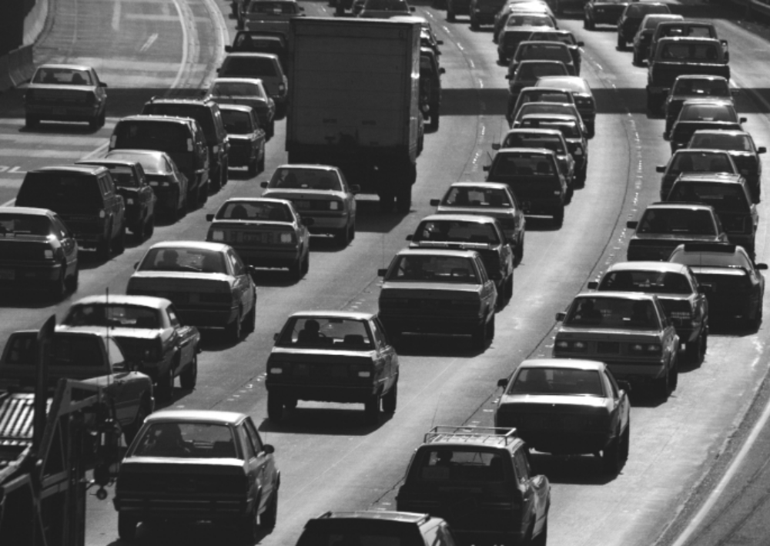
Rewriting Practice
Rewrite the following passage into an academic one.
Why are there so many jams on the roads these days? One thing is that public transportation like trains, buses, etc., is so dear. A long time ago cars cost a lot but now, unfortunately, they’ve got a lot cheaper. Another thing is that driving is a lot nicer than waiting for a bus. The trouble is that if everyone buys a car the roads get packed.

Slide 18
Key for Reference
Why are there so many jams on the roads these days? One thing is that public transportation like trains, buses, etc., is so dear. A long time ago cars cost a lot but now, unfortunately, they’ve got a lot cheaper. Another thing is that driving is a lot nicer than waiting for a bus. The trouble is that if everyone buys a car the roads get packed.
There appear to be two principal reasons for the growing traffic congestion. Firstly, public transportation has become increasingly expensive in relation to the falling cost of driving. In addition, car ownership is more convenient than using public transportation. Together these factors result in higher vehicle density.

Slide 19
Choose appropriate styles
P7
Which of the following sentences you would like to use for your academic writing?
1. He couldn’t finish his work within the given time.
2. The first set of results were compiled and presented by the other group of students.
3. I would like to focus on the following areas of research.
4. They argued that this methodology was unreliable.
5. In addition, the data was used to focus on the following hypothesis.
6. I enjoyed my English class with you and has a good experience this semester.
7. At about 12 p.m. on August 21, 1984, she told us, that I came out of the kitchen to toss out some water.
8. we, at any rate, will continue to keep an open mind.
9. Is the spoken language at the French restaurant giving your trouble? Then you might need the Voice, a hand-held computer that translates spoken English into French, Spanish, German or Italian.
10. There is an emerging consensus that a concerted effort on a national level will be required to capture the glittering prizes that a new technology offers.

Slide 20
No. | Y/N | Reason(s) for your choice
1
2
3
4
5
6
7
8
9
10
N
An oral expression
Y
The passive voice
N
The 1st person singular; an oral expression
Y
Presenting others’ opinion
Y
The passive voice
N
The 1st person singular
N
A loosely organized sentence
N
A subjective/consultative voice
N
An advertisement about a new translation machine
Y
Structural complexity; the passive voice

Slide 21

Academic Writing Course
Thank You !

